Slide 1
Unit 3
SQL

Slide 2
Topics Covered
SQL commands,
Constraints,
Joins,
set operations,
Sub queries,
Views,
PL – SQL,
Triggers, and Cursors.

Slide 3
Basics of SQL-DDL,DML,DCL,TCL Nested Queries, Views and its Structure Creation, alternation Types
Defining Constraints-Primary Key, Foreign Key, Transaction Control Commands Unique, not null, check, IN operator Commit, Rollback, Savepoint
Functions-aggregation functions PL/SQL Concepts- Cursors
Built-in Functions-numeric, date, string
functions, string functions, Set operations, Stored Procedure, Functions Triggers and Exceptional Handling
Sub Queries, correlated sub queries Query Processing

Slide 4
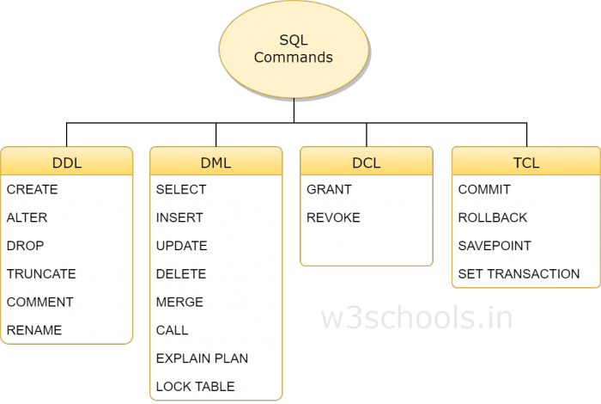
Basics of SQL
DDL is Data Definition Language statements
Some examples
CREATE - to create objects in the database
ALTER - alters the structure of the database
DROP - delete objects from the database
TRUNCATE - remove all records from a table
COMMENT - add comments to the data dictionary

Slide 5
DML is Data Manipulation Language statements
Some examples:
SELECT - retrieve data from the a database
INSERT - insert data into a table
UPDATE - updates existing data within a table
DELETE - deletes all records from a table, the space for the records remain
CALL - call a PL/SQL or Java subprogram
EXPLAIN PLAN - explain access path to data
LOCK TABLE - control concurrency

Slide 6
TCL(Transaction Control Language) is a DML
COMMIT - save work done
SAVEPOINT - identify a point in a transaction to which you can later roll back
ROLLBACK - restore database to original since the last COMMIT
SET TRANSACTION - Change transaction options like what rollback segment to use
DCL is Data Control Language statements
Some examples:
GRANT - gives user's access privileges to database
REVOKE - withdraw access privileges given with the GRANT command

Slide 7
Data-Definition Language
Set of definitions expressed by a special language called a data-definition language (DDL).
The storage structure and access methods used by the database system by a set of statements in a special type of DDL called a data storage and definition language.
The data values stored in the database must satisfy certain consistency constraints.
Domain Constraints: A domain of possible values must be associated with every attribute (for example, integer types, character types, date/time types).
Domain constraints are the most elementary form of integrity constraint.
Referential Integrity: There are cases where we wish to ensure that a value that appears in one relation for a given set of attributes also appears in a certain set of attributes in another relation (referential integrity).
Database modifications can cause violations of referential integrity.
Assertions: An assertion is any condition that the database must always satisfy. Domain constraints and referential-integrity constraints are special forms of assertions.
Authorization: To differentiate among the users as far as the type of access they are permitted on various data values in the database. These differentiations are expressed in terms of authorization.

Slide 8
Read Authorization - which allows reading, but not modification of data.
Insert Authorization - which allows insertion of new data but not modification of existing data.
update authorization - which allows modification but not deletion of data.
Delete Authorization - which allows deletion of data.
The output of the DDL is placed in the data dictionary which contains metadata - that is, data about data.
SQL provides a rich DDL that allows one to define tables, integrity constraints, assertions, etc.
create table department (dept name char (20), building char (15), budget numeric (12,2));
Execution of the above DDL statement creates the department table with three columns: dept name, building, and budget, each of which has a specific data type associated with it.

Slide 9
CREATING DATABASE TABLE
CREATE – creates a new table in the database
Used to create a table by defining its structure, the data type and name of the various columns, the relationships with columns of other tables etc.
CREATE TABLE table_name (column_name1 data_type(size), column_name2 data_type(size),…., column_nameN data_type(size));
E.g.:
CREATE TABLE Employee(Name varchar2(20), DOB date, Salary number(6));

Slide 10
ALTER - Add a new attribute or Modify the characteristics of some existing attribute.
ALTER TABLE table_name ADD (column_name1 data_type (size), column_name2 data_type (size),….., column_nameN data_type (size));
E.g.:
ALTER TABLE Employee ADD (Address varchar2(20));
ALTER TABLE Employee ADD (Designation varchar2(20), Dept varchar2(3));

Slide 11
ALTER TABLE table_name MODIFY (column_name data_type(new_size));
E.g.:
ALTER TABLE Employee MODIFY (Name varchar2(30));
ALTER - dropping a column from the table
ALTER TABLE table_name DROP COLUMN column_name;
E.g.:
ALTER TABLE Student DROP COLUMN Age;

Slide 12
DROP - Deleting an entire table from the database.
DROP TABLE table_name;
E.g.:
DROP TABLE Employee
RENAME – Renaming the table
RENAME old_table_name TO new_table_name;
E.g.:
RENAME Employee TO Employee_details

Slide 13
TRUNCATE – deleting all rows from a table and free the space containing the table.
TRUNCATE TABLE table_name;
E.g.:
TRUNCATE TABLE Employee_details;

Slide 14
Data Manipulation Language
A DML statement is executed when you
Add new rows to a table
Modify existing rows in a table
Remove existing rows from a table

Slide 15
Add new rows to a table by using the INSERT statement.
1. INSERT INTO table VALUES(value1, value2,..);
Only one row is inserted at a time with this syntax.
List values in the default order of the columns in the table
Enclose character and date values within single quotation marks.
Insert a new row containing values for each column.
E.g.:
INSERT INTO Employee VALUES (‘ashok’, ‘16-mar-1998’, 30000);
2. INSERT INTO table(column1, column2,..)VALUES(value1, value2,..);
Rows can be inserted with NULL values either
by omitting column from the column list or
by specifying NULL in the value field.
E.g.:
INSERT INTO Employee (name, dob, salary) VALUES (‘ashok’, ‘16-mar-1998’, 30000);

Slide 16
3. INSERT INTO table_name1 SELECT column_name1, column_name2,….,column_nameN FROM table_name2;
INSERT INTO Employee_details SELECT name, dob FROM Exmployee;

Slide 17
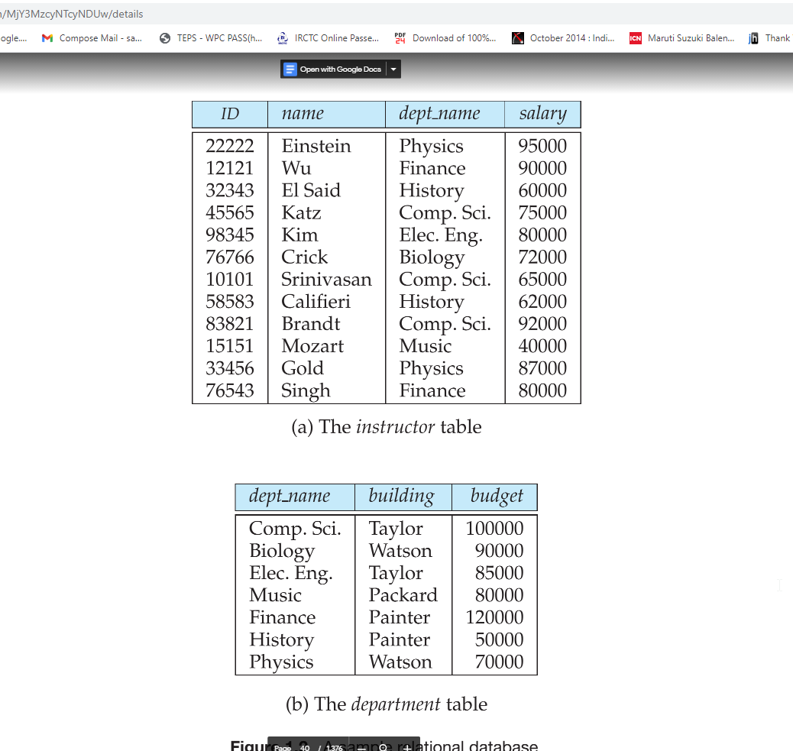
Data-Manipulation Language (DML)
The SQL query language is nonprocedural.
select instructor.name from instructor where instructor.dept name = ’History’;
Queries may involve information from more than one table.
select instructor.ID, department.dept name from instructor, department where instructor.dept name= department.dept name and department.budget > 95000;

Slide 18
Basics of SQL-DDL,DML,DCL,TCL Nested Queries, Views and its Structure Creation, alternation Types
Defining Constraints-Primary Key, Foreign Key, Transaction Control Commands Unique, not null, check, IN operator Commit, Rollback, Savepoint
Functions-aggregation functions PL/SQL Concepts- Cursors
Built-in Functions-numeric, date, string
functions, string functions, Set operations, Stored Procedure, Functions Triggers and Exceptional Handling
Sub Queries, correlated sub queries Query Processing

Slide 19
SQL Constraints
Constraints are the rules that we can apply on the type of data in a table. That is, we can specify the limit on the type of data that can be stored in a particular column in a table using constraints.
Constraints in SQL
Not Null
Unique
Primary Key
Foreign Key
Check
Default
How to specify constraints?
We can specify constraints at the time of creating the table using CREATE TABLE statement. We can also specify the constraints after creating a table using ALTER TABLE statement.

Slide 20
Syntax
CREATE TABLE sample_table(column1 data_type(size) constraint_name, column2 data_type(size) constraint_name, column3 data_type(size) constraint_name, .... );
sample_table: Name of the table to be created.
data_type: Type of data that can be stored in the field.
constraint_name: Name of the constraint. for example- NOT NULL, UNIQUE, PRIMARY KEY etc.

Slide 21
NOT NULL
If we specify a field in a table to be NOT NULL.
Then the field will never accept null value.
That is, you will be not allowed to insert a new row in the table without specifying any value to this field.
E.g.
CREATE TABLE Student ( ID int(6) NOT NULL, NAME varchar(10) NOT NULL, ADDRESS varchar(20) );

Slide 22
UNIQUE
This constraint helps to uniquely identify each row in the table. i.e. for a particular column, all the rows should have unique values. We can have more than one UNIQUE columns in a table.
E.g.
CREATE TABLE Student ( ID int(6) NOT NULL UNIQUE, NAME varchar(10), ADDRESS varchar(20) );

Slide 23
PRIMARY KEY
Primary Key is a field which uniquely identifies each row in the table.
If a field in a table as primary key, then the field will not be able to contain NULL values as well as all the rows should have unique values for this field.
In other words we can say that this is combination of NOT NULL and UNIQUE constraints.
A table can have only one field as primary key.
E.g.
CREATE TABLE Student ( ID int(6) NOT NULL UNIQUE, NAME varchar(10), ADDRESS varchar(20), PRIMARY KEY(ID) );

Slide 24
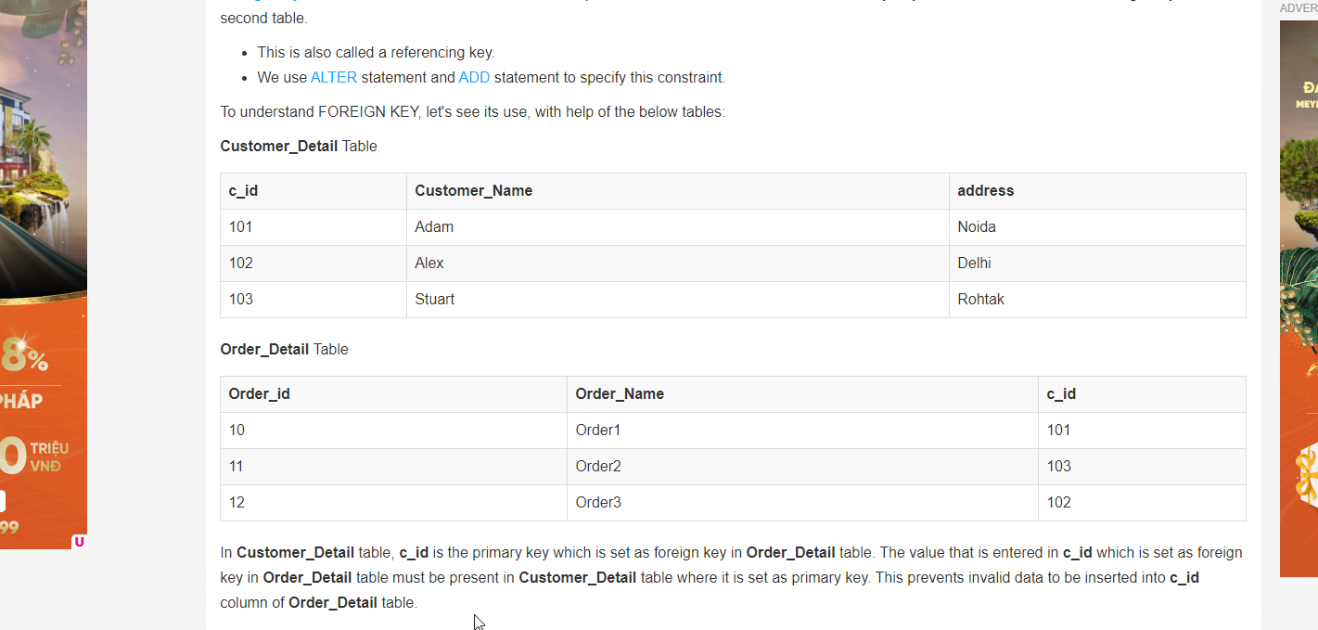
FOREIGN KEY
Foreign Key is a field in a table which uniquely identifies each row of a another table.
That is, this field points to primary key of another table. This usually creates a kind of link between the tables.
Foreign Key is used to relate two tables. The relationship between the two tables matches the Primary Key in one of the tables with a Foreign Key in the second table.
This is also called a referencing key.
We use ALTER statement and ADD statement to specify this constraint.

Slide 25
In Customer_Detail table, c_id is the primary key which is set as foreign key in Order_Detail table.
The value that is entered in c_id which is set as foreign key in Order_Detail table must be present in Customer_Detail table where it is set as primary key.
This prevents invalid data to be inserted into c_id column of Order_Detail table.
FOREIGN KEY constraint at Table Level
CREATE table Order_Detail( order_id int PRIMARY KEY, order_name varchar(60) NOT NULL, c_id int FOREIGN KEY REFERENCES Customer_Detail(c_id) );
FOREIGN KEY constraint at Column Level
ALTER table Order_Detail ADD FOREIGN KEY (c_id) REFERENCES Customer_Detail(c_id);

Slide 26
CHECK Constraint
CHECK constraint is used to restrict the value of a column between a range.
It performs check on the values, before storing them into the database.
It’s like condition checking before saving data into a column.
Using CHECK constraint at Table Level
CREATE table Student( s_id int NOT NULL CHECK(s_id > 0), Name varchar(60) NOT NULL, Age int );
Using CHECK constraint at Column Level
ALTER table Student ADD CHECK(s_id > 0);

Slide 27
DEFAULT
This constraint is used to provide a default value for the fields.
That is, if at the time of entering new records in the table if the user does not specify any value for these fields then the default value will be assigned to them.
E.g.
CREATE TABLE Student ( ID int(6) NOT NULL, NAME varchar(10) NOT NULL, AGE int DEFAULT 18 );

Slide 28
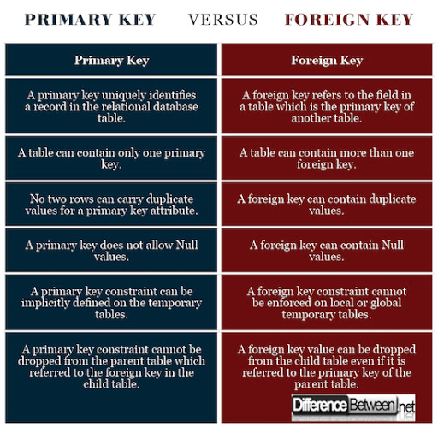
Primary Key Vs Foreign Key

Slide 29
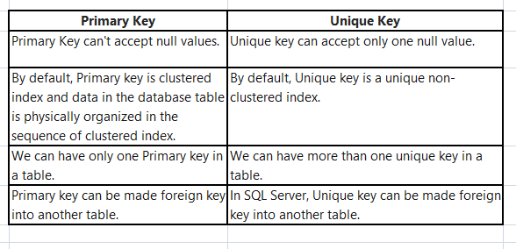
Primary Key Vs Unique Key

Slide 30
Basics of SQL-DDL,DML,DCL,TCL Views and its Types
Structure Creation, alternation
Defining Constraints-Primary Key, Foreign Key, Transaction Control Commands Unique, not null, check, IN operator Commit, Rollback, Savepoint
Functions-aggregation functions PL/SQL Concepts- Cursors
Built-in Functions-numeric, date, string
functions, string functions, Set operations, Stored Procedure, Functions Triggers and Exceptional Handling
Sub Queries, correlated sub queries Query Processing
Nested Queries,

Slide 31
Aggregate functions in SQL
In database management an aggregate function is a function where the values of multiple rows are grouped together as input on certain criteria to form a single value of more significant meaning.
Various Aggregate Functions are
Count()
Sum()
Avg()
Min()
Max()

Slide 32
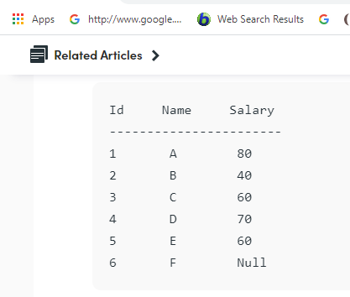
Count()
Count(*): Returns total number of records .i.e 6.
Count(salary): Return number of Non Null values over the column salary. i.e 5.
Count(Distinct Salary): Return number of distinct Non Null values over the column salary .i.e 4

Slide 33
Sum()
sum(salary): Sum all Non Null values of
Column salary i.e., 310
sum(Distinct salary): Sum of all distinct
Non-Null values i.e., 250.
Avg()
Avg(salary) = Sum(salary) / count(salary) = 310/5
Avg(Distinct salary) = sum(Distinct salary) / Count(Distinct Salary) = 250/4
Min(), Max()
Min(salary): Minimum value in the salary column except NULL i.e., 40.
Max(salary): Maximum value in the salary i.e., 80.

Slide 34
Built in Functions - Numeric Functions in SQL
ABS(): It returns the absolute value of a number.
Syntax: SELECT ABS(-243.5);
Output: 243.5
ACOS(): It returns the cosine of a number.
Syntax: SELECT ACOS(0.25);
Output: 1.318116071652818
ASIN(): It returns the arc sine of a number.
Syntax: SELECT ASIN(0.25);
Output: 0.25268025514207865
ATAN(): It returns the arc tangent of a number.
Syntax: SELECT ATAN(2.5);
Output: 1.1902899496825317
CEIL(): It returns the smallest integer value that is greater than or equal to a number.
Syntax: SELECT CEIL(25.75);
Output: 26
CEILING(): It returns the smallest integer value that is greater than or equal to a number.
Syntax: SELECT CEILING(25.75);
Output: 26
COS(): It returns the cosine of a number.
Syntax: SELECT COS(30);
Output: 0.15425144988758405

Slide 35
Built in Functions - Numeric Functions in SQL
COT(): It returns the cotangent of a number.
Syntax: SELECT COT(6);
Output: -3.436353004180128
DEGREES(): It converts a radian value into degrees.
Syntax: SELECT DEGREES(1.5);
Output: 85.94366926962348
DIV(): It is used for integer division.
Syntax: SELECT 10 DIV 5;
Output: 2
EXP(): It returns e raised to the power of number.
Syntax: SELECT EXP(1);
Output: 2.718281828459045
FLOOR(): It returns the largest integer value that is less than or equal to a number.
Syntax: SELECT FLOOR(25.75);
Output: 25
GREATEST(): It returns the greatest value in a list of expressions.
Syntax: SELECT GREATEST(30, 2, 36, 81, 125);
Output: 125
LEAST(): It returns the smallest value in a list of expressions.
Syntax: SELECT LEAST(30, 2, 36, 81, 125);
Output: 2
LN(): It returns the natural logarithm of a number.
Syntax: SELECT LN(2);
Output: 0.6931471805599453
LOG10(): It returns the base-10 logarithm of a number.
Syntax: SELECT LOG(2);
Output: 0.6931471805599453

Slide 36
Built in Functions - Numeric Functions in SQL
LOG2(): It returns the base-2 logarithm of a number.
Syntax: SELECT LOG2(6);
Output: 2.584962500721156
MOD(): It returns the remainder of n divided by m.
Syntax: SELECT MOD(18, 4);
Output: 2
PI(): It returns the value of PI displayed with 6 decimal places.
Syntax: SELECT PI();
Output: 3.141593
POW(): It returns m raised to the nth power.
Syntax: SELECT POW(4, 2);
Output: 16
RADIANS(): It converts a value in degrees to radians.
Syntax: SELECT RADIANS(180);
RAND(): It returns a random number.
Syntax: SELECT RAND();
Output: 0.33623238684258644
ROUND(): It returns a number rounded to a certain number of decimal places.
Syntax: SELECT ROUND(5.553);
Output: 6
SIGN(): It returns a value indicating the sign of a number.
Syntax: SELECT SIGN(255.5);
Output: 1
SIN(): It returns the sine of a number.
Syntax: SELECT SIN(2);
Output: 0.9092974268256817

Slide 37
Built in Functions - Numeric Functions in SQL
SQRT(): It returns the square root of a number.
Syntax: SELECT SQRT(25);
Output: 5
TAN(): It returns the tangent of a number.
Syntax: SELECT TAN(1.75);
Output: -5.52037992250933
ATAN2(): It returns the arctangent of the x and y coordinates, as an angle and expressed in radians.
Syntax: SELECT ATAN2(7);
Output: 1.42889927219073
TRUNCATE(): This doesn’t work for SQL Server. It returns 7.53635 truncated to 2 places right of the decimal point.
Syntax: SELECT TRUNCATE(7.53635, 2);
Output: 7.53

Slide 38
Built in Functions - String functions in SQL
ASCII(): This function is used to find the ASCII value of a character.
Syntax: SELECT ascii('t’);
Output: 116
CHAR_LENGTH(): Doesn’t work for SQL Server. Use LEN() for SQL Server. This function is used to find the length of a word. Syntax: SELECT char_length('Hello!’);
Output: 6
CHARACTER_LENGTH(): Doesn’t work for SQL Server. Use LEN() for SQL Server. This function is used to find the length of a line.
Syntax: SELECT CHARACTER_LENGTH('geeks for geeks’);
Output: 15
CONCAT(): This function is used to add two words or strings.
Syntax: SELECT 'Geeks' || ' ' || 'forGeeks';
Output: ‘GeeksforGeeks’
CONCAT_WS(): This function is used to add two words or strings with a symbol as concatenating symbol.
Syntax: SELECT CONCAT_WS('_', 'geeks', 'for', 'geeks’);
Output: geeks_for_geeks
FIND_IN_SET(): This function is used to find a symbol from a set of symbols.
Syntax: SELECT FIND_IN_SET('b', 'a, b, c, d, e, f’);
Output: 2
FORMAT(): This function is used to display a number in the given format.
Syntax: Format("0.981", "Percent");
Output: ‘98.10%’

Slide 39
Built in Functions - String functions in SQL
INSTR(): This function is used to find the occurrence of an alphabet.
Syntax: INSTR('geeks for geeks', 'e’);
Output: 2 (the first occurrence of ‘e’)
Syntax: INSTR('geeks for geeks', 'e', 1, 2 );
Output: 3 (the second occurrence of ‘e’)
LCASE(): This function is used to convert the given string into lower case.
Syntax: LCASE ("GeeksFor Geeks To Learn");
Output: geeksforgeeks to learn
LEFT(): This function is used to SELECT a sub string from the left of given size or characters.
Syntax: SELECT LEFT('geeksforgeeks.org', 5);
Output: geeks
LENGTH(): This function is used to find the length of a word.
Syntax: LENGTH('GeeksForGeeks’);
Output: 13
LOCATE(): This function is used to find the nth position of the given word in a string.
Syntax: SELECT LOCATE('for', 'geeksforgeeks', 1);
Output: 6
LOWER(): This function is used to convert the upper case string into lower case.
Syntax: SELECT LOWER('GEEKSFORGEEKS.ORG’);
Output: geeksforgeeks.org
LPAD(): This function is used to make the given string of the given size by adding the given symbol.
Syntax: LPAD('geeks', 8, '0’);
Output: 000geeks

Slide 40
Built in Functions - String functions in SQL
LTRIM(): This function is used to cut the given sub string from the original string.
Syntax: LTRIM('123123geeks', '123’);
Output: geeks
MID(): This function is to find a word from the given position and of the given size.
Syntax: Mid ("geeksforgeeks", 6, 2);
Output: for
POSITION(): This function is used to find position of the first occurrence of the given alphabet.
Syntax: SELECT POSITION('e' IN 'geeksforgeeks’);
Output: 2
REPEAT(): This function is used to write the given string again and again till the number of times mentioned.
Syntax: SELECT REPEAT('geeks', 2);
Output: geeksgeeks
REPLACE(): This function is used to cut the given string by removing the given sub string.
Syntax: REPLACE('123geeks123', '123’);
Output: geeks
REVERSE(): This function is used to reverse a string.
Syntax: SELECT REVERSE('geeksforgeeks.org’);
Output: ‘gro.skeegrofskeeg’
RIGHT(): This function is used to SELECT a sub string from the right end of the given size.
Syntax: SELECT RIGHT('geeksforgeeks.org', 4);
Output: ‘.org’
RPAD(): This function is used to make the given string as long as the given size by adding the given symbol on the right.
Syntax: RPAD('geeks', 8, '0’);
Output: ‘geeks000’
RTRIM(): This function is used to cut the given sub string from the original string.
Syntax: RTRIM('geeksxyxzyyy', 'xyz’);
Output: ‘geeks’
SPACE(): This function is used to write the given number of spaces.
Syntax: SELECT SPACE(7);
Output: ‘ ‘

Slide 41
Built in Functions - String functions in SQL
STRCMP(): This function is used to compare 2 strings.
If string1 and string2 are the same, the STRCMP function will return 0.
If string1 is smaller than string2, the STRCMP function will return -1.
If string1 is larger than string2, the STRCMP function will return 1.
Syntax: SELECT STRCMP('google.com', 'geeksforgeeks.com’);
Output: -1
SUBSTR(): This function is used to find a sub string from the a string from the given position.
Syntax:SUBSTR('geeksforgeeks', 1, 5);
Output: ‘geeks’
SUBSTRING(): This function is used to find an alphabet from the mentioned size and the given string.
Syntax: SELECT SUBSTRING('GeeksForGeeks.org', 9, 1);
Output: ‘G’
SUBSTRING_INDEX(): This function is used to find a sub string before the given symbol.
Syntax: SELECT SUBSTRING_INDEX('www.geeksforgeeks.org', '.', 1);
Output: ‘www’
TRIM(): This function is used to cut the given symbol from the string.
Syntax: TRIM(LEADING '0' FROM '000123’);
Output: 123
UCASE(): This function is used to make the string in upper case.
Syntax: UCASE ("GeeksForGeeks");
Output: GEEKSFORGEEKS

Slide 42
Built in Functions - Date functions in SQL
NOW(): Returns the current date and time.
Example: SELECT NOW();
Output:2017-01-13 08:03:52
CURDATE(): Returns the current date.
Example: SELECT CURDATE();
Output: 2017-01-13
CURTIME(): Returns the current time.
Example: SELECT CURTIME();
Output: 08:05:15
DATE(): Extracts the date part of a date or date/time expression.
EXTRACT(): Returns a single part of a date/time.
Syntax: EXTRACT(unit FORM date);
SELECT Name, Extract(DAY FROM BirthTime) AS BirthDay FROM Test;

Slide 43
Built in Functions - Date functions in SQL
DATE_ADD() : Adds a specified time interval to a date
Syntax: DATE_ADD(date, INTERVAL expr type);
SELECT Name, DATE_ADD(BirthTime, INTERVAL 1 YEAR) AS BirthTimeModified FROM Test;
DATE_SUB(): Subtracts a specified time interval from a date. Syntax for DATE_SUB is same as DATE_ADD just the difference is that DATE_SUB is used to subtract a given interval of date.
DATEDIFF(): Returns the number of days between two dates.
Syntax: DATEDIFF(date1, date2); date1 & date2- date/time expression
SELECT DATEDIFF('2017-01-13','2017-01-03') AS DateDiff;
Output:10

Slide 44
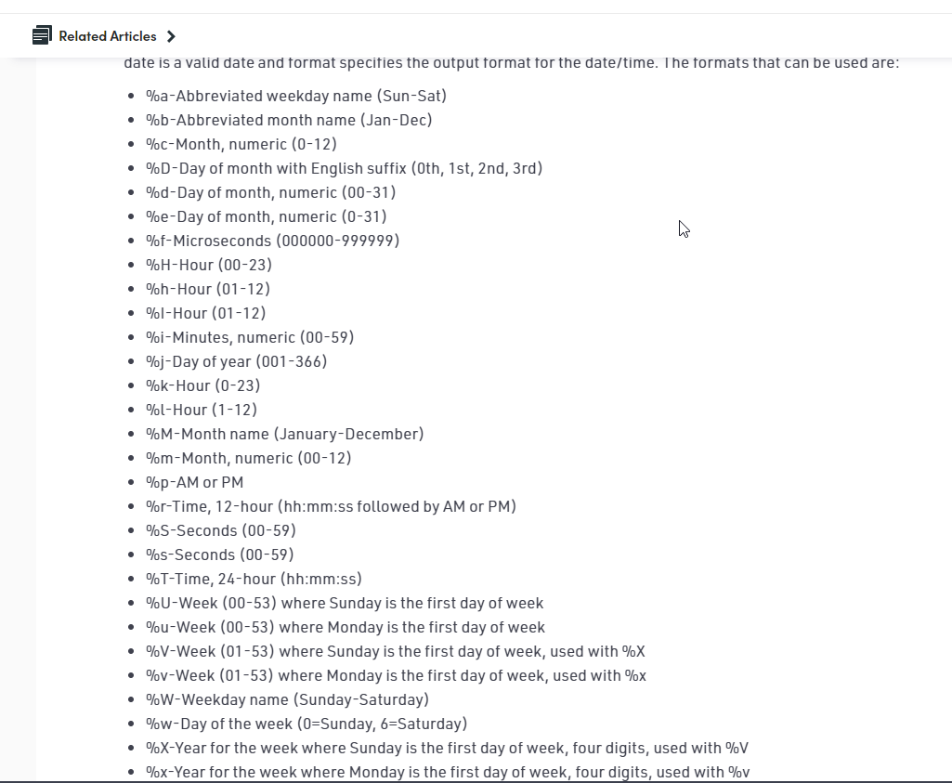
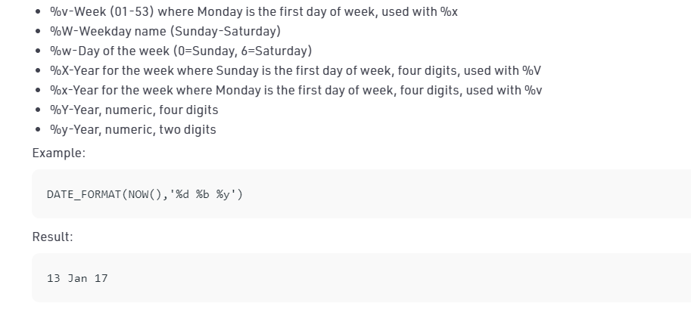
Built in Functions - Date functions in SQL
DATE_FORMAT(): Displays date/time data in different formats.
Syntax: DATE_FORMAT(date,format);

Slide 45
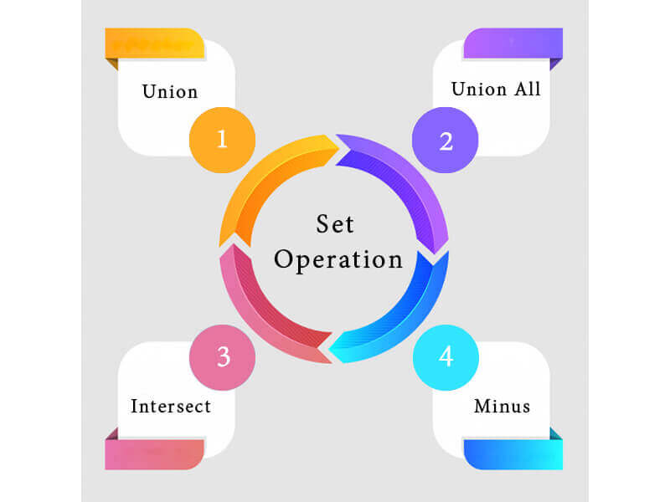
Set Operation functions in SQL
The SQL Set operation is used to combine the two or more SQL SELECT statements.
Types of Set Operation

Slide 46
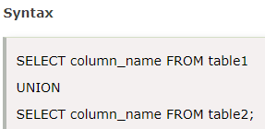
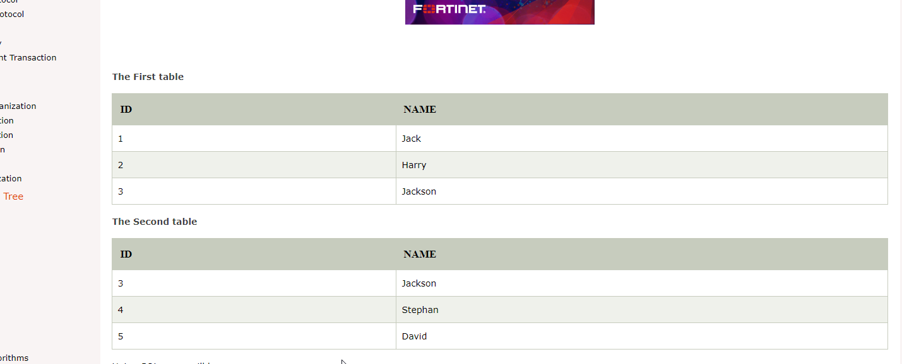
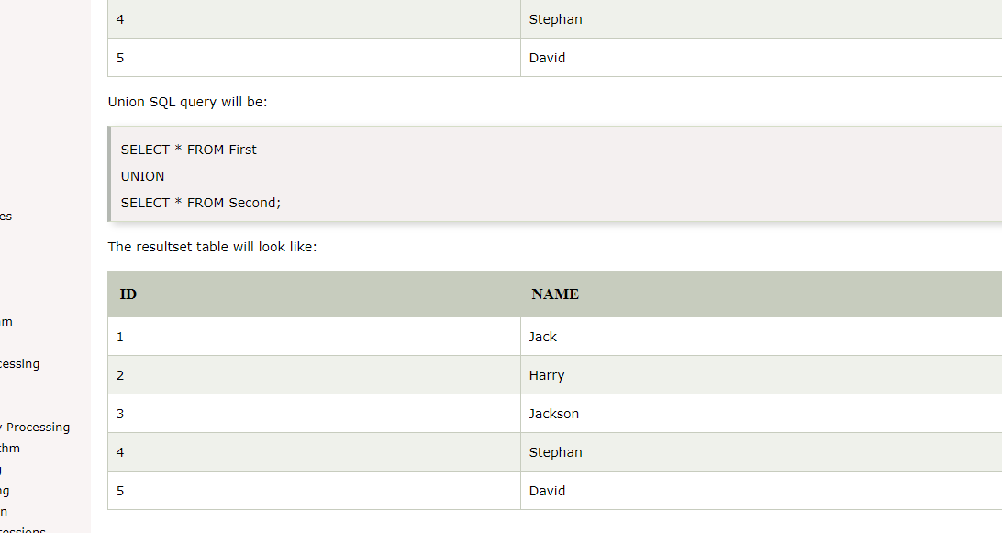
UNION Operation
UNION is used to combine the results of two or more SELECT statements.
However it will eliminate duplicate rows from its resultset.
In case of union, number of columns and datatype must be same in both the tables, on which UNION operation is being applied.

Slide 47
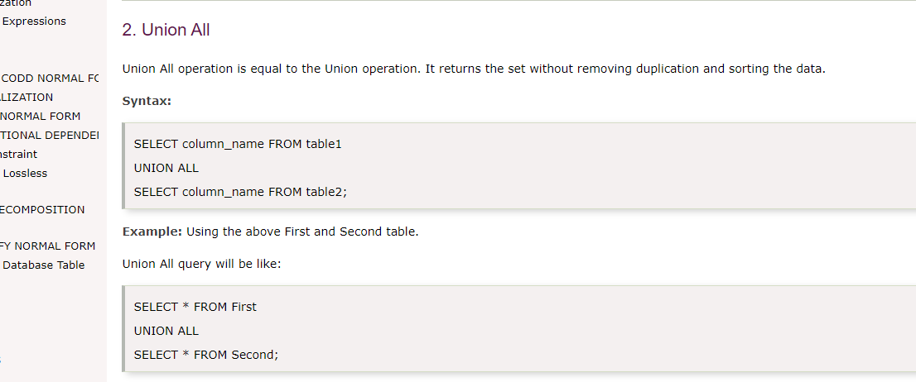
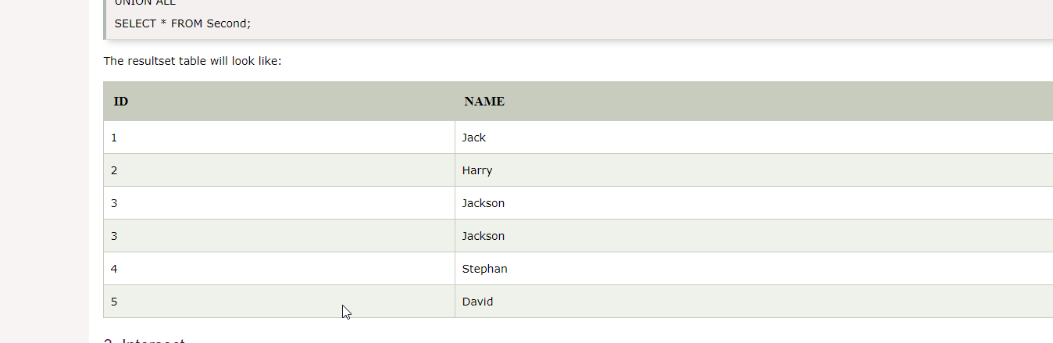
Union All
Union All operation is equal to the Union operation. It returns the set without removing duplication and sorting the data.

Slide 48
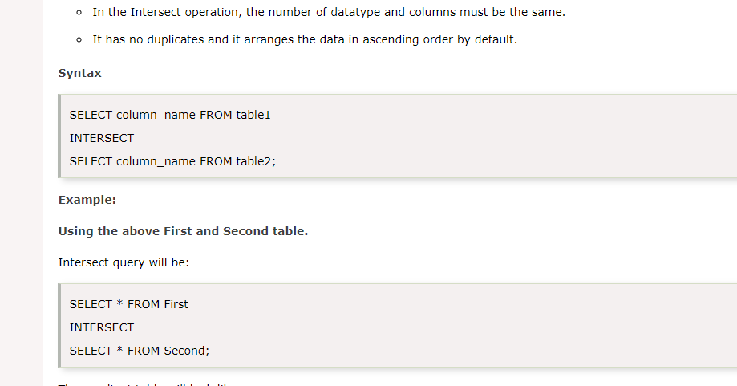
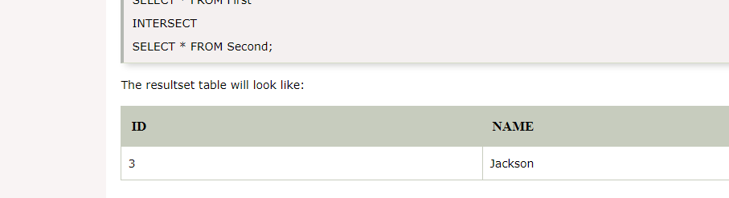
Intersect
It is used to combine two SELECT statements. The Intersect operation returns the common rows from both the SELECT statements.
In the Intersect operation, the number of datatype and columns must be the same.
It has no duplicates and it arranges the data in ascending order by default.

Slide 49
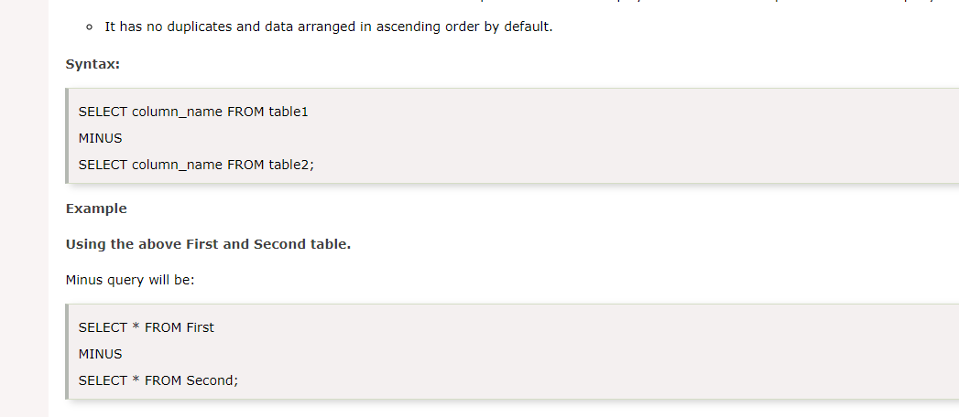
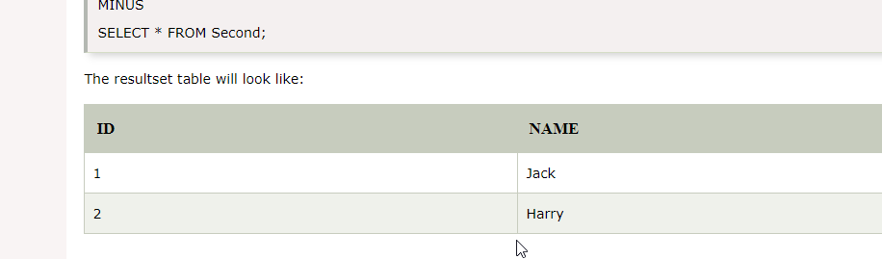
Minus
It combines the result of two SELECT statements. Minus operator is used to display the rows which are present in the first query but absent in the second query.
It has no duplicates and data arranged in ascending order by default.

Slide 50
Basics of SQL-DDL,DML,DCL,TCL Views and its Types
Structure Creation, alternation
Defining Constraints-Primary Key, Foreign Key, Transaction Control Commands Unique, not null, check, IN operator Commit, Rollback, Savepoint
Functions-aggregation functions PL/SQL Concepts- Cursors
Built-in Functions-numeric, date, string
functions, string functions, Set operations, Stored Procedure, Functions Triggers and Exceptional Handling
Sub Queries, correlated sub queries Query Processing
Nested Queries,

Slide 51
Subquery
Subquery can be simply defined as a query within another query. In other words we can say that a Subquery is a query that is embedded in WHERE clause of another SQL query.
Important rules for Subqueries
You can place the Subquery in a number of SQL clauses: WHERE clause, HAVING clause, FROM clause. Subqueries can be used with SELECT, UPDATE, INSERT, DELETE statements along with expression operator. It could be equality operator or comparison operator such as =, >, =, <= and Like operator.
A subquery is a query within another query. The outer query is called as main query and inner query is called as subquery.
The subquery generally executes first, and its output is used to complete the query condition for the main or outer query.
Subquery must be enclosed in parentheses.
Subqueries are on the right side of the comparison operator.
ORDER BY command cannot be used in a Subquery. GROUPBY command can be used to perform same function as ORDER BY command.
Use single-row operators with singlerow Subqueries. Use multiple-row operators with multiple-row Subqueries.

Slide 52
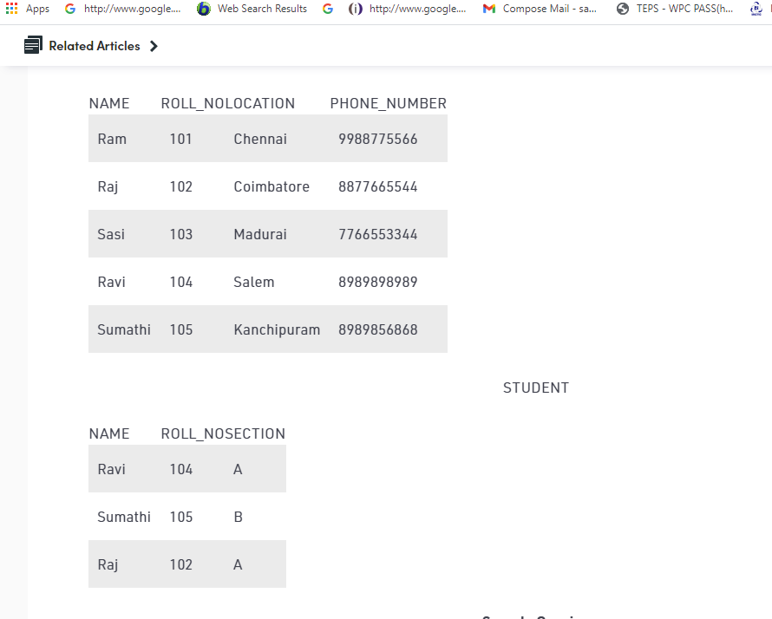
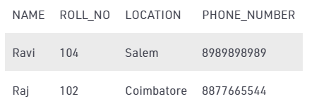
Subqueries with SELECT statement
Syntax
SELECT column_name FROM table_name WHERE column_name expression operator ( SELECT COLUMN_NAME from TABLE_NAME WHERE ... );
Select NAME, LOCATION, PHONE_NUMBER from DATABASE WHERE ROLL_NO IN (SELECT ROLL_NO from STUDENT where SECTION=’A’);

Slide 53
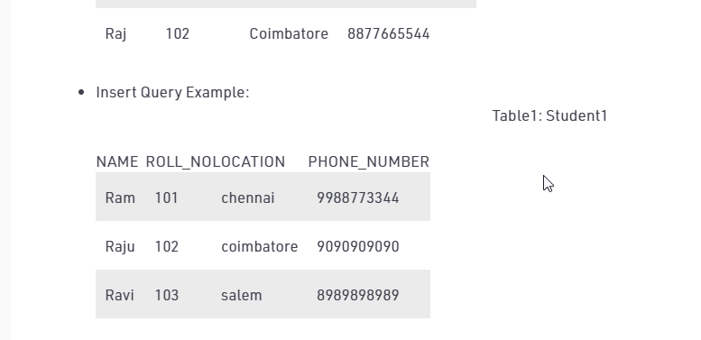
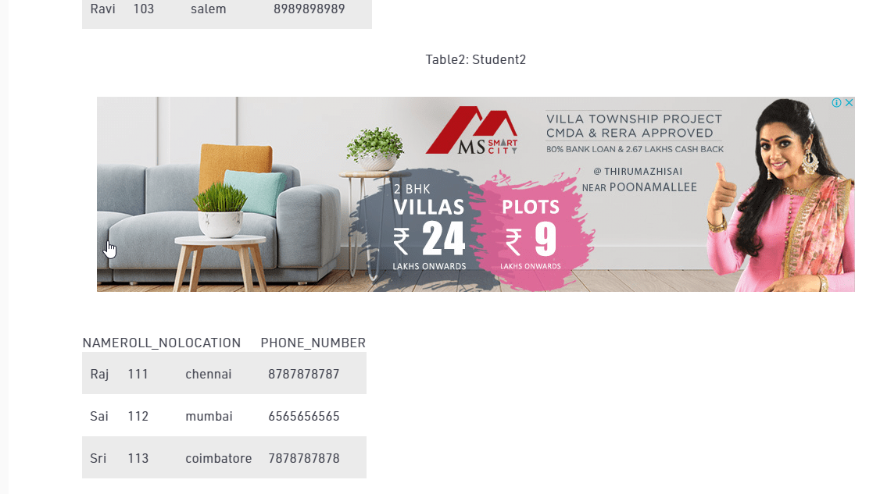
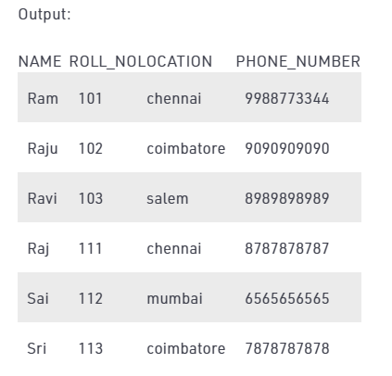
Subqueries with the INSERT Statement
Subqueries also can be used with INSERT statements.
The INSERT statement uses the data returned from the subquery to insert into another table.
The selected data in the subquery can be modified with any of the character, date or number functions.
INSERT INTO Student1 SELECT * FROM Student2;

Slide 54
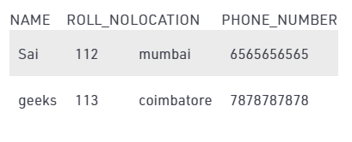
Subqueries with the UPDATE Statement
The subquery can be used in conjunction with the UPDATE statement. Either single or multiple columns in a table can be updated when using a subquery with the UPDATE statement.
To update name of the students to geeks in Student2 table whose location is same as Raju,Ravi in Student1 table
UPDATE Student2 SET NAME=’geeks’ WHERE LOCATION IN ( SELECT LOCATION FROM Student1 WHERE NAME IN (‘Raju’,’Ravi’));

Slide 55
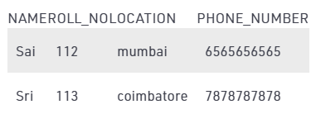
Subqueries with the DELETE Statement
The subquery can be used in conjunction with the DELETE statement like with any other statements mentioned above.
To delete students from Student2 table whose rollno is same as that in Student1 table and having location as Chennai.
DELETE FROM Student2 WHERE ROLL_NO IN ( SELECT ROLL_NO FROM Student1 WHERE LOCATION = ’chennai’);

Slide 56
Nested Subqueries Versus Correlated Subqueries
With a normal nested subquery, the inner SELECT query runs first and executes once, returning values to be used by the main query.
A correlated subquery, however, executes once for each candidate row considered by the outer query. In other words, the inner query is driven by the outer query.
NOTE : You can also use the ANY and ALL operator in a correlated subquery.

Slide 57
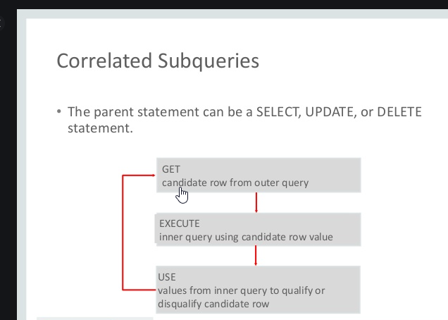
SQL Correlated Subqueries
Correlated subqueries are used for row-by-row processing. Each subquery is executed once for every row of the outer query.
A correlated subquery is evaluated once for each row processed by the parent statement. The parent statement can be a SELECT, UPDATE, or DELETE statement.
A correlated subquery is one way of reading every row in a table and comparing values in each row against related data.
It is used whenever a subquery must return a different result or set of results for each candidate row considered by the main query.

Slide 58
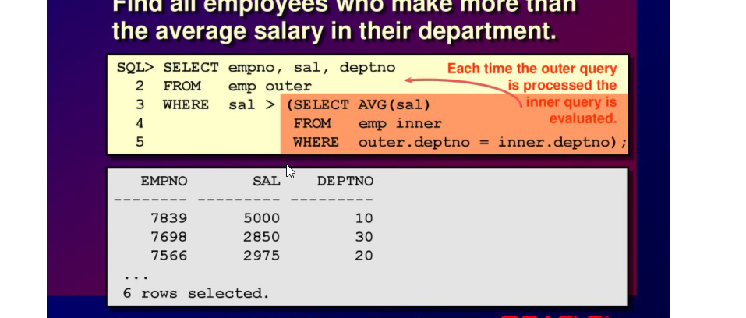
Correlated Subqueries with Select Statement
Find all the employees who earn more than the average salary in their department.

Slide 59
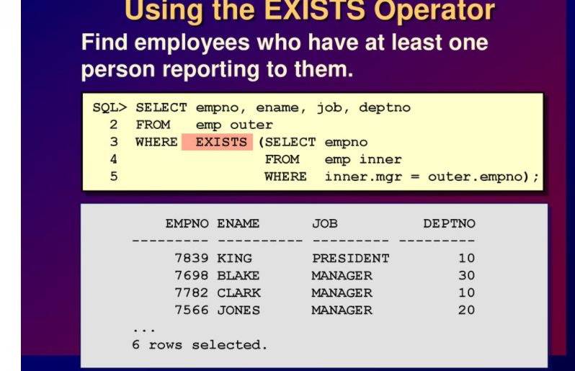
Using the Exists Operator
The EXISTS operator tests for existence of rows in the results set of the subquery.
If a subquery row value is found the condition is flagged TRUE and the search does not continue in the inner query, and if it is not found then the condition is flagged FALSE and the search continues in the inner query.
Find the employees who have at least one person reporting to them.

Slide 60
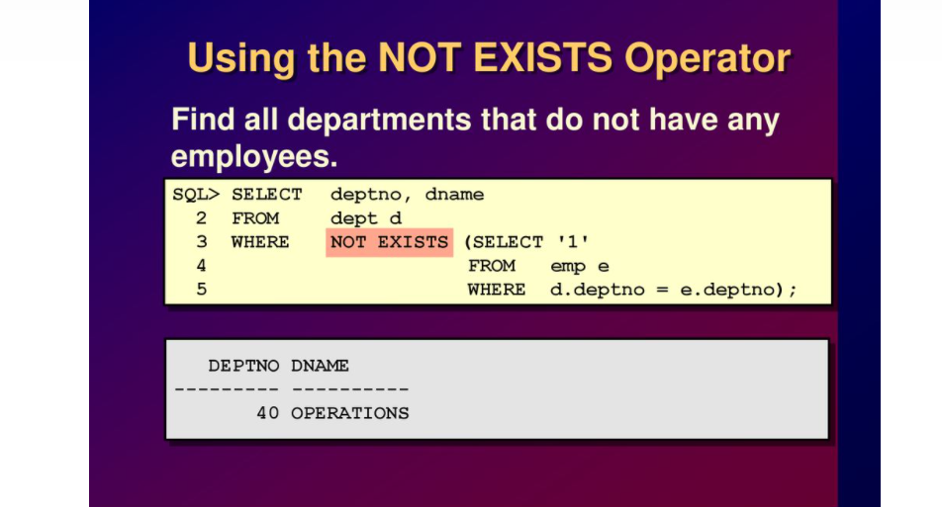
Using the Not Exists Operator
Find all the departments that do not have any employees

Slide 61
CORRELATED UPDATE & DELETE
CORRELATED UPDATE
UPDATE table1 alias1 SET column = (SELECT expression FROM table2 alias2 WHERE alias1.column = alias2.column);
Use a correlated subquery to update rows in one table based on rows from another table.
CORRELATED DELETE
DELETE FROM table1 alias1 WHERE column1 operator (SELECT expression FROM table2 alias2 WHERE alias1.column = alias2.column);
Use a correlated subquery to delete rows in one table based on the rows from another table.

Slide 62
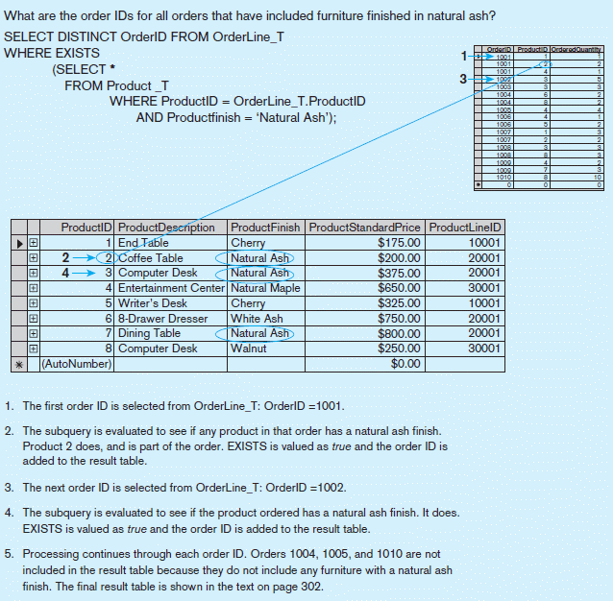
Processing a correlated subquery Using the Exists Operator - E.g.
Note: Only the orders that involve products with Natural Ash will be included in the final results.

Slide 63
Basics of SQL-DDL,DML,DCL,TCL Views and its Types
Structure Creation, alternation
Defining Constraints-Primary Key, Foreign Key, Transaction Control Commands Unique, not null, check, IN operator Commit, Rollback, Savepoint
Functions-aggregation functions PL/SQL Concepts- Cursors
Built-in Functions-numeric, date, string
functions, string functions, Set operations, Stored Procedure, Functions Triggers and Exceptional Handling
Sub Queries, correlated sub queries Query Processing
Nested Queries,

Slide 64
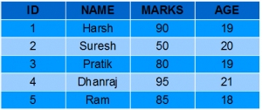
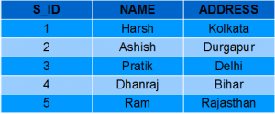
SQL Views
Views in SQL are kind of virtual tables.
A view also has rows and columns as they are in a real table in the database.
We can create a view by selecting fields from one or more tables present in the database.
A View can either have all the rows of a table or specific rows based on certain condition.
Student Details
Student Marks

Slide 65
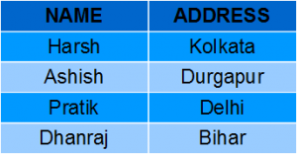
Creating a View
View can be created using CREATE VIEW statement. A View can be created from a single table or multiple tables.
Syntax
CREATE VIEW view_name AS SELECT column1, column2..... FROM table_name WHERE condition;
view_name: Name for the View
table_name: Name of the table
condition: Condition to select rows
Creating View from a single table
CREATE VIEW DetailsView AS SELECT NAME, ADDRESS FROM StudentDetails WHERE S_ID < 5;
To see the data in the View, we can query the view in the same manner as we query a table.
SELECT * FROM DetailsView;
Student Details
Output

Slide 66
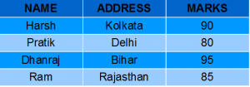
Creating View from multiple tables
In this example we will create a View named MarksView from two tables StudentDetails and StudentMarks.
To create a View from multiple tables we can simply include multiple tables in the SELECT statement.
CREATE VIEW MarksView AS SELECT StudentDetails.NAME, StudentDetails.ADDRESS, StudentMarks.MARKS FROM StudentDetails, StudentMarks WHERE StudentDetails.NAME = StudentMarks.NAME;
To display data of View MarksView:
SELECT * FROM MarksView;
Student Details
Student Marks
Output

Slide 67
DELETING VIEWS
SQL allows us to delete an existing View. We can delete or drop a View using the DROP statement.
Syntax
DROP VIEW view_name;
view_name: Name of the View which we want to delete.
For example, if we want to delete the View MarksView.
DROP VIEW MarksView;

Slide 68
UPDATING VIEWS
There are certain conditions needed to be satisfied to update a view. If any one of these conditions is not met, then we will not be allowed to update the view.
The SELECT statement which is used to create the view should not include GROUP BY clause or ORDER BY clause.
The SELECT statement should not have the DISTINCT keyword.
The View should have all NOT NULL values.
The view should not be created using nested queries or complex queries.
The view should be created from a single table. If the view is created using multiple tables then we will not be allowed to update the view.

Slide 69

CREATE OR REPLACE VIEW
We can use the CREATE OR REPLACE VIEW statement to add or remove fields from a view.
Syntax
CREATE OR REPLACE VIEW view_name AS SELECT column1,coulmn2,.. FROM table_name WHERE condition;
For example, if we want to update the view MarksView and add the field AGE to this View from StudentMarks Table, we can do this as:
CREATE OR REPLACE VIEW MarksView AS SELECT StudentDetails.NAME, StudentDetails.ADDRESS, StudentMarks.MARKS, StudentMarks.AGE FROM StudentDetails, StudentMarks WHERE StudentDetails.NAME = StudentMarks.NAME;
If we fetch all the data from MarksView now as:
SELECT * FROM MarksView;
Output

Slide 70
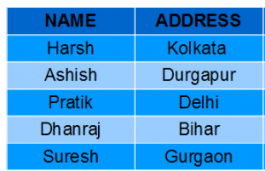
Inserting a row in a view
We can insert a row in a View in a same way as we do in a table. We can use the INSERT INTO statement of SQL to insert a row in a View.
Syntax:
INSERT INTO view_name(column1, column2 , column3,..) VALUES(value1, value2, value3..); view_name: Name of the View
Example: In the below example we will insert a new row in the View DetailsView which we have created above in the example of “creating views from a single table”.
INSERT INTO DetailsView(NAME, ADDRESS) VALUES("Suresh","Gurgaon");
If we fetch all the data from DetailsView now as,
SELECT * FROM DetailsView;
Output

Slide 71
Deleting a row from a View
Deleting rows from a view is also as simple as deleting rows from a table.
We can use the DELETE statement of SQL to delete rows from a view.
Also deleting a row from a view first delete the row from the actual table and the change is then reflected in the view.
Syntax
DELETE FROM view_name WHERE condition;
view_name:Name of view from where we want to delete rows
condition: Condition to select rows
In this example we will delete the last row from the view DetailsView which we just added in the above example of inserting rows.
DELETE FROM DetailsView WHERE NAME="Suresh";
If we fetch all the data from DetailsView now as,
SELECT * FROM DetailsView;
Output

Slide 72
Uses of a View
Restricting data access Views provide an additional level of table security by restricting access to a predetermined set of rows and columns of a table.
Hiding data complexity A view can hide the complexity that exists in a multiple table join.
Simplify commands for the user Views allows the user to select information from multiple tables without requiring the users to actually know how to perform a join.
Store complex queries Views can be used to store complex queries.
Rename Columns Views can also be used to rename the columns without affecting the base tables provided the number of columns in view must match the number of columns specified in select statement. Thus, renaming helps to to hide the names of the columns of the base tables.
Multiple view facility Different views can be created on the same table for different users.

Slide 73
Basics of SQL-DDL,DML,DCL,TCL Nested Queries, Views and its Structure Creation, alternation Types
Defining Constraints-Primary Key, Foreign Key, Transaction Control Commands Unique, not null, check, IN operator Commit, Rollback, Savepoint
Functions-aggregation functions PL/SQL Concepts- Cursors
Built-in Functions-numeric, date, string
functions, string functions, Set operations, Stored Procedure, Functions Triggers and Exceptional Handling
Sub Queries, correlated sub queries Query Processing

Slide 74
TRANSACTION
A transaction is a unit of work that is performed against a database. Transactions are units or sequences of work accomplished in a logical order, whether in a manual fashion by a user or automatically by some sort of a database program.
A transaction is the propagation of one or more changes to the database. For example, if you are creating a record or updating a record or deleting a record from the table, then you are performing a transaction on that table. It is important to control these transactions to ensure the data integrity and to handle database errors.
Practically, you will club many SQL queries into a group and you will execute all of them together as a part of a transaction.

Slide 75
Transaction Control language is a language that manages transactions within the database. It is used to execute the changes made by the DML statements.
TCL Commands
Transaction Control Language (TCL) Commands are:
Commit − It is used to save the transactions in the database.
Rollback − It is used to restore the database to that state which was last committed.
Savepoint − The changes done till savpoint will be unchanged and all the transactions after savepoint will be rolled back.

Slide 76
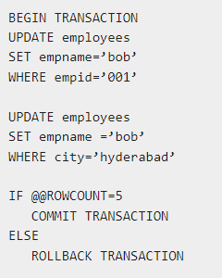
Example
Given below is an example of the usage of the TCL commands in the database management system (DBMS)

Slide 77
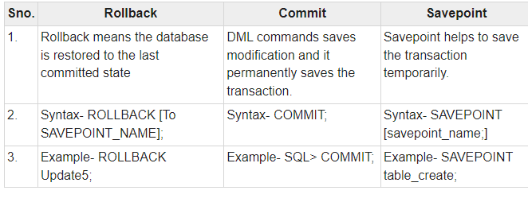
Difference between Commit, rollback and savepoint of TCL commands

Slide 78
Properties of Transactions
Transactions have the following four standard properties, usually referred to by the acronym ACID.
Atomicity − ensures that all operations within the work unit are completed successfully. Otherwise, the transaction is aborted at the point of failure and all the previous operations are rolled back to their former state.
Consistency − ensures that the database properly changes states upon a successfully committed transaction.
Isolation − enables transactions to operate independently of and transparent to each other.
Durability − ensures that the result or effect of a committed transaction persists in case of a system failure.

Slide 79
Transaction Control
The following commands are used to control transactions.
COMMIT − to save the changes.
ROLLBACK − to roll back the changes.
SAVEPOINT − creates points within the groups of transactions in which to ROLLBACK.

Slide 80
COMMIT
Transactional control commands are only used with the DML Commands such as - INSERT, UPDATE and DELETE only.
They cannot be used while creating tables or dropping them because these operations are automatically committed in the database
The COMMIT command is the transactional command used to save changes invoked by a transaction to the database.

Slide 81
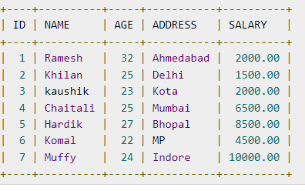
Example Consider the CUSTOMERS table having the following records

Slide 82

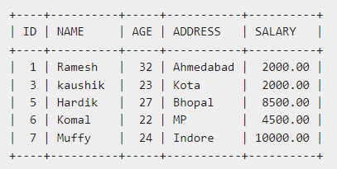
Following is an example which would delete those records from the table which have age = 25 and then COMMIT the changes in the database.
Thus, two rows from the table would be deleted and the SELECT statement would produce the following result.

Slide 83

ROLLBACK Command
The ROLLBACK command is the transactional command used to undo transactions that have not already been saved to the database.
This command can only be used to undo transactions since the last COMMIT or ROLLBACK command was issued.
The syntax for a ROLLBACK command is as follows :

Slide 84
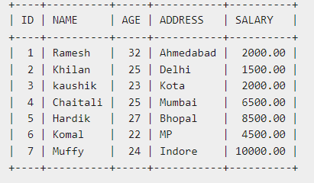

Example Consider the CUSTOMERS table having the following records
Following is an example, which would delete those records from the table which have the age = 25 and then ROLLBACK the changes in the database.

Slide 85
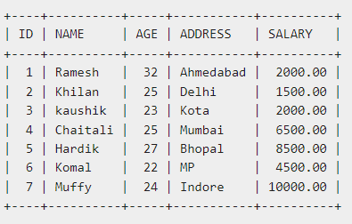
Thus, the delete operation would not impact the table and the SELECT statement would produce the following result.
select * from customers;

Slide 86


SAVEPOINT
A SAVEPOINT is a point in a transaction when you can roll the transaction back to a certain point without rolling back the entire transaction. The syntax for a SAVEPOINT command is as shown below.
This command serves only in the creation of a SAVEPOINT among all the transactional statements. The ROLLBACK command is used to undo a group of transactions.
The syntax for rolling back to a SAVEPOINT is as shown below.

Slide 87
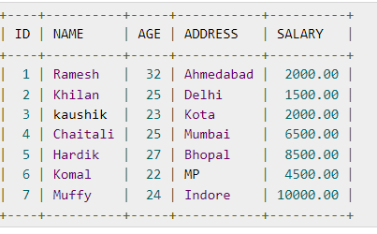
Following is an example where you plan to delete the three different records from the CUSTOMERS table. You want to create a SAVEPOINT before each delete, so that you can ROLLBACK to any SAVEPOINT at any time to return the appropriate data to its original state.
Example
Consider the CUSTOMERS table having the following records.

Slide 88
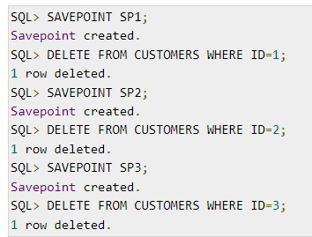

The following code block contains the series of operations.
Now that the three deletions have taken place, let us assume that you have changed your mind and decided to ROLLBACK to the SAVEPOINT that you identified as SP2. Because SP2 was created after the first deletion, the last two deletions are undone −

Slide 89
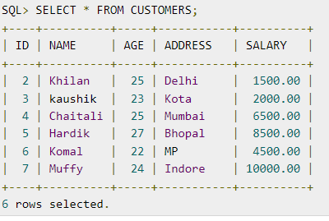
Notice that only the first deletion took place since you rolled back to SP2.

Slide 90

RELEASE SAVEPOINT Command: The RELEASE SAVEPOINT command is used to remove a SAVEPOINT that you have created.
The syntax for a RELEASE SAVEPOINT command is as follows:
Once a SAVEPOINT has been released, you can no longer use the ROLLBACK command to undo transactions performed since the last SAVEPOINT.

Slide 91
Basics of SQL-DDL,DML,DCL,TCL Nested Queries, Views and its Structure Creation, alternation Types
Defining Constraints-Primary Key, Foreign Key, Transaction Control Commands Unique, not null, check, IN operator Commit, Rollback, Savepoint
Functions-aggregation functions PL/SQL Concepts- Cursors
Built-in Functions-numeric, date, string
functions, string functions, Set operations, Stored Procedure, Functions Triggers and Exceptional Handling
Sub Queries, correlated sub queries Query Processing

Slide 92
Introduction to PL/SQL
Procedural Language extension for SQL
Oracle Proprietary
3GL Capabilities
Integration of SQL
Portable within Oracle data bases
Callable from any client

Slide 93
Structure of PL/SQL
PL/SQL is Block Structured
A block is the basic unit from which all PL/SQL programs are built. A block can be named (functions and procedures) or anonymous
Sections of block
1- Header Section
2- Declaration Section
3- Executable Section
4- Exception Section

Slide 94
Structure of PL/SQL
HEADER
Type and Name of block
DECLARE
Variables; Constants; Cursors;
BEGIN
PL/SQL and SQL Statements
EXCEPTION
Exception handlers
END;

Slide 95
Structure of PL/SQL
DECLARE
a number;
text1 varchar2(20);
text2 varchar2(20) := “HI”;
BEGIN
---------- ---------- ----------
END;
Important Data Types in PL/SQL include NUMBER, INTEGER, CHAR, VARCHAR2, DATE etc
to_date(‘02-05-2007','dd-mm-yyyy') { Converts String to Date}

Slide 96
Structure of PL/SQL
Data Types for specific columns
Variable_name Table_name.Column_name%type;
This syntax defines a variable of the type of the referenced column on the referenced table

Slide 97
PL/SQL Control Structure
PL/SQL has a number of control structures which includes:
Conditional controls
Iterative or loop controls.
Exception or error controls
These control structure, can be used singly or together, that allow the PL/SQL developer to direct the flow of execution through the program.

Slide 98
PL/SQL Control Structure
Conditional Controls
IF....THEN....END IF;
IF....THEN...ELSE....END IF;
IF....THEN...ELSIF....THEN....ELSE....END IF;

Slide 99
PL/SQL Control Structure
LOOP
...SQL Statements...
EXIT;
END LOOP;
WHILE loops
WHILE condition LOOP
...SQL Statements...
END LOOP;
FOR loops
FOR <variable(numeric)> IN [REVERSE] <lowerbound>..<upperbound> LOOP .... ..... END LOOP;

Slide 100
Cursor
A cursor is a pointer to this context area. PL/SQL controls the context area through a cursor. A cursor holds the rows (one or more) returned by a SQL statement. The set of rows the cursor holds is referred to as the active set.
There are two types of cursors −
Implicit cursors
Explicit cursors

Slide 101
Implicit Cursors
Implicit cursors are automatically created by Oracle whenever an SQL statement is executed, when there is no explicit cursor for the statement.
Programmers cannot control the implicit cursors and the information in it.
In PL/SQL, the most recent implicit cursor is the SQL cursor, which has the following attributes.

Slide 102
Implicit Cursors
S.No | Attribute & Description
1 | %FOUND Returns TRUE if an INSERT, UPDATE, or DELETE statement affected one or more rows or a SELECT INTO statement returned one or more rows. Otherwise, it returns FALSE.
2 | %NOTFOUND The logical opposite of %FOUND. It returns TRUE if an INSERT, UPDATE, or DELETE statement affected no rows, or a SELECT INTO statement returned no rows. Otherwise, it returns FALSE.
3 | %ISOPEN Always returns FALSE for implicit cursors, because Oracle closes the SQL cursor automatically after executing its associated SQL statement.
4 | %ROWCOUNT Returns the number of rows affected by an INSERT, UPDATE, or DELETE statement, or returned by a SELECT INTO statement.

Slide 103
Example
The following program will update the employee table and increase the salary of each customer by 500 and use the SQL%ROWCOUNT attribute to determine the number of rows affected −
DECLARE
total_rows number(2);
BEGIN
UPDATE customers
SET salary = salary + 500;
IF sql%notfound THEN
dbms_output.put_line('no customers selected');
ELSIF sql%found THEN
total_rows := sql%rowcount;
dbms_output.put_line( total_rows || ' customers selected ');
END IF;
END;
Output:
6 customers selected

Slide 104
Explicit Cursors
Explicit cursors are programmer-defined cursors for gaining more control over the context area. An explicit cursor should be defined in the declaration section of the PL/SQL Block. It is created on a SELECT Statement which returns more than one row.
The syntax for creating an explicit cursor is −
CURSOR cursor_name IS select_statement;
Working with an explicit cursor includes the following steps −
Declaring the cursor for initializing the memory
Opening the cursor for allocating the memory
Fetching the cursor for retrieving the data
Closing the cursor to release the allocated memory

Slide 105
Cursor-Declaration
Declaring the Cursor
Declaring the cursor defines the cursor with a name and the associated SELECT statement.
For example −
CURSOR c_customers IS SELECT id, name, address FROM customers;
Opening the Cursor
Opening the cursor allocates the memory for the cursor and makes it ready for fetching the rows returned by the SQL statement into it. For example, we will open the above defined cursor as follows −
OPEN c_customers;
Fetching the Cursor
Fetching the cursor involves accessing one row at a time. For example, we will fetch rows from the above-opened cursor as follows −
FETCH c_customers INTO c_id, c_name, c_addr;
Closing the Cursor
Closing the cursor means releasing the allocated memory. For example, we will close the above-opened cursor as follows −
CLOSE c_customers;

Slide 106
Example
DECLARE
c_id customers.id%type;
c_name customer.name%type;
c_addr customers.address%type;
CURSOR c_customers is
SELECT id, name, address FROM customers;
BEGIN
OPEN c_customers;
LOOP
FETCH c_customers into c_id, c_name, c_addr;
EXIT WHEN c_customers%notfound;
dbms_output.put_line(c_id || ' ' || c_name || ' ' || c_addr);
END LOOP;
CLOSE c_customers;
END;
/
Output:
1 Ramesh Ahmedabad
2 Khilan Delhi
3 kaushik Kota
4 Chaitali Mumbai
5 Hardik Bhopal
6 Komal MP

Slide 107
Basics of SQL-DDL,DML,DCL,TCL Views and its Types
Structure Creation, alternation
Defining Constraints-Primary Key, Foreign Key, Transaction Control Commands Unique, not null, check, IN operator Commit, Rollback, Savepoint
Functions-aggregation functions PL/SQL Concepts- Cursors
Built-in Functions-numeric, date, string
functions, string functions, Set operations, Stored Procedure, Functions Triggers and Exceptional Handling
Sub Queries, correlated sub queries Query Processing
Nested Queries,

Slide 108
Stored Procedure
A stored procedure in SQL is a group of SQL statements that are stored together in a database.
Based on the statements in the procedure and the parameters you pass, it can perform one or multiple DML operations on the database, and return value, if any.
Stored Procedure is a function in a shared library accessible to the database server
can also write stored procedures using languages such as C or Java
: Reduced network traffic
The more SQL statements that are grouped together for execution, the larger the savings in network traffic

Slide 109
Advantages of stored procedure
Reusable: As mentioned, multiple users and applications can easily use and reuse stored procedures by merely calling it.
Easy to modify: You can quickly change the statements in a stored procedure as and when you want to, with the help of the ALTER TABLE command.
Security: Stored procedures allow you to enhance the security of an application or a database by restricting the users from direct access to the table.
Low network traffic: The server only passes the procedure name instead of the whole query, reducing network traffic.
Increases performance: Upon the first use, a plan for the stored procedure is created and stored in the buffer pool for quick execution for the next time.

Slide 110
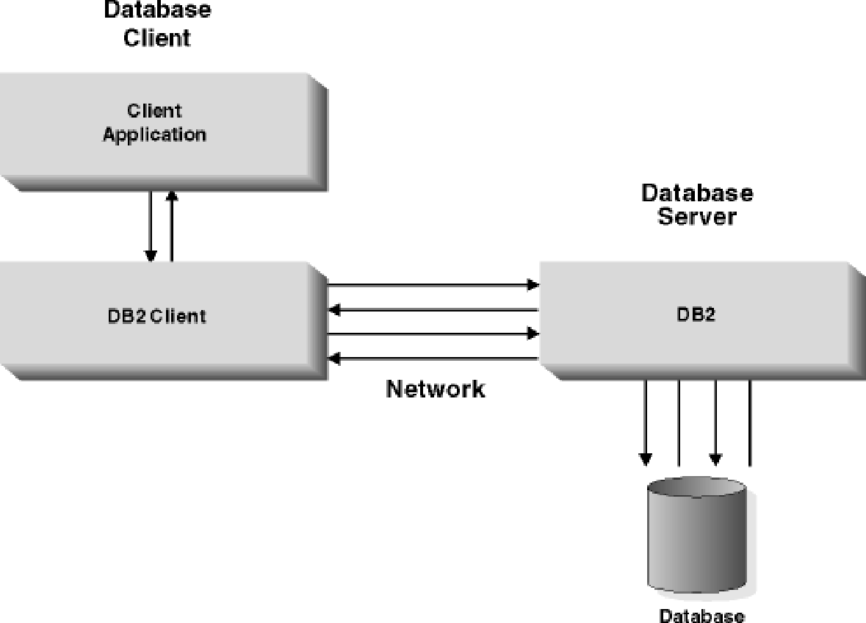
Normal Database

Slide 111
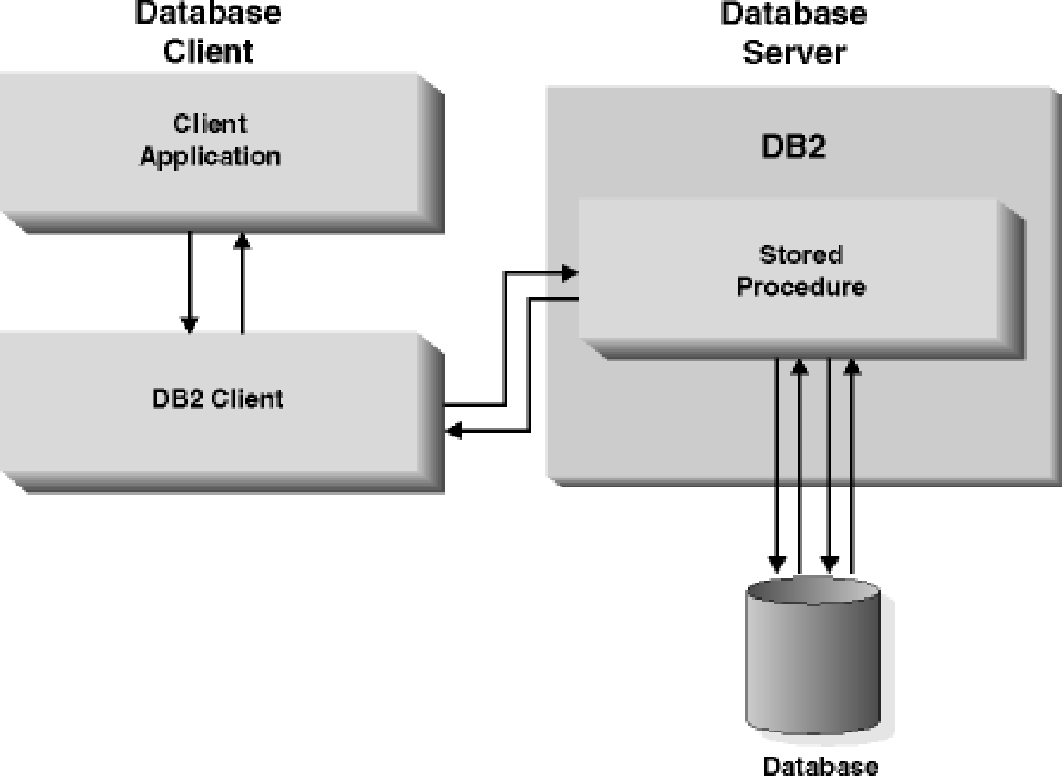
Applications using stored procedures

Slide 112
Writing Stored Procedures
CREATE or REPLACE PROCEDURE name(parameters)
AS
variables;
BEGIN;
//statements;
END;
Three types of parameters are:
IN: It is the default parameter that will receive input value from the program
OUT: It will send output value to the program
IN OUT: It is the combination of both IN and OUT. Thus, it receives from, as well as sends a value to the program

Slide 113
EXAMPLE:
CREATE PROCEDURE UPDATE_SALARY_1 (1)
(IN EMPLOYEE_NUMBER CHAR(6), (2)
IN RATE INTEGER) (2)
LANGUAGE SQL (3)
BEGIN
UPDATE EMPLOYEE (4)
SET SALARY = SALARY * (1.0 * RATE / 100.0 )
WHERE SSN = EMPLOYEE_NUMBER;
END
LANGUAGE value of SQL and the BEGIN...END block, which forms the procedure body, are particular to an SQL procedure
1)The stored procedure name is UPDATE_SALARY_1.
2)The two parameters have data types of CHAR(6) and INTEGER. Both are input parameters.
3)LANGUAGE SQL indicates that this is an SQL procedure, so a procedure body follows the other parameters.
4)The procedure body consists of a single SQL UPDATE statement, which updates rows in the employee table.

Slide 114
Some Valid SQL Procedure Body Statements
CASE statement
FOR statement
GOTO statement
IF statement
ITERATE statement
RETURN statement
WHILE statement

Slide 115
Invoking Procedures
Can invoke Stored procedure stored at the location of the database by using the SQL CALL statement
Nested SQL Procedures:
To call a target SQL procedure from within a caller SQL procedure, simply include a CALL statement with the appropriate number and types of parameters in your caller.
CREATE PROCEDURE NEST_SALES(OUT budget DECIMAL(11,2))
LANGUAGE SQL
BEGIN
DECLARE total INTEGER DEFAULT 0;
SET total = 6;
CALL SALES_TARGET(total);
SET budget = total * 10000;
END

Slide 116
CONDITIONAL STATEMENTS:
IF <condition> THEN
<statement(s)>
ELSE
<statement(s)>
END IF;
Loops
LOOP
……
EXIT WHEN <condition> ……
END LOOP;

Slide 117
EXAMPLE :
CREATE PROCEDURE UPDATE_SALARY_IF
(IN employee_number CHAR(6), IN rating SMALLINT)
LANGUAGE SQL
BEGIN
SET counter = 10;
WHILE (counter > 0) DO
IF (rating = 1)
THEN UPDATE employee
SET salary = salary * 1.10, bonus = 1000
WHERE empno = employee_number;
ELSEIF (rating = 2)
THEN UPDATE employee
SET salary = salary * 1.05, bonus = 500
WHERE empno = employee_number;
ELSE UPDATE employee
SET salary = salary * 1.03, bonus = 0
WHERE empno = employee_number;
END IF;
SET counter = counter – 1;
END WHILE;
END
@

Slide 118
EXAMPLE
CREATE OR REPLACE TRIGGER display_salary_changes
BEFORE DELETE OR INSERT OR UPDATE ON customers
FOR EACH ROW
WHEN (NEW.ID > 0)
DECLARE
sal_diff number;
BEGIN
sal_diff := :NEW.salary - :OLD.salary;
dbms_output.put_line('Old salary: ' || :OLD.salary);
dbms_output.put_line('New salary: ' || :NEW.salary);
dbms_output.put_line('Salary difference: ' || sal_diff);
END;

Slide 119
After creating a Trigger, use it in the PL/SQL code for putting it in to action.
DECLARE
total_rows number(2);
BEGIN
UPDATE customers
SET salary = salary + 5000;
IF sql%notfound THEN
dbms_output.put_line('no customers updated');
ELSIF sql%found THEN
total_rows := sql%rowcount;
dbms_output.put_line( total_rows || ' customers updated ');
END IF;
END;
/

Slide 120
Advantages of Triggers
Triggers can be written for the following purposes −
Generating some derived column values automatically
Enforcing referential integrity
Event logging and storing information on table access
Auditing
Synchronous replication of tables
Imposing security authorizations
Preventing invalid transactions

Slide 121
Basics of SQL-DDL,DML,DCL,TCL Views and its Types
Structure Creation, alternation
Defining Constraints-Primary Key, Foreign Key, Transaction Control Commands Unique, not null, check, IN operator Commit, Rollback, Savepoint
Functions-aggregation functions PL/SQL Concepts- Cursors
Built-in Functions-numeric, date, string
functions, string functions, Set operations, Stored Procedure, Functions Triggers and Exceptional Handling
Sub Queries, correlated sub queries Query Processing
Nested Queries,

Slide 122
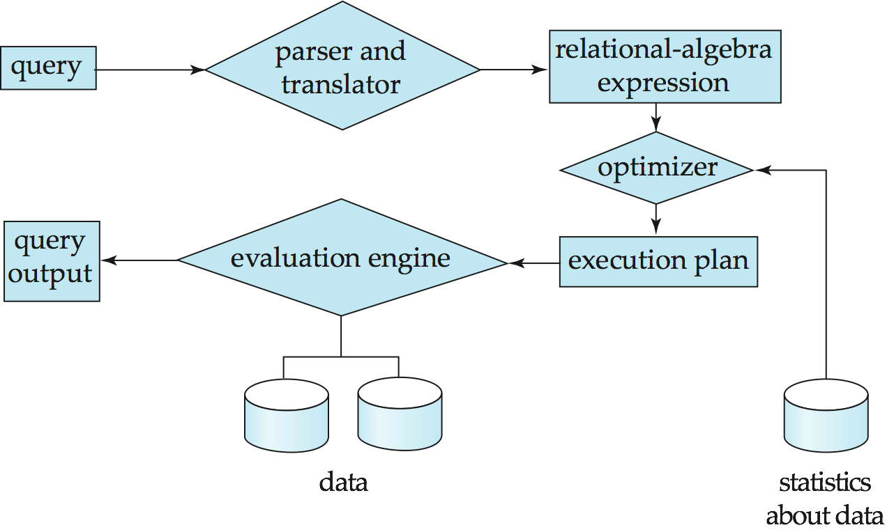
Query Processing
1. Parsing and translation
2. Optimization
3. Evaluation
Notes:
‹#›

Slide 123
Query Processing (Cont.)
Alternative ways of evaluating a given query
Equivalent expressions
Different algorithms for each operation
Cost difference between a good and a bad way of evaluating a query can be enormous
Need to estimate the cost of operations
Depends critically on statistical information about relations which the database must maintain
Need to estimate statistics for intermediate results to compute cost of complex expressions
Notes:
‹#›

Slide 124
Transaction Management
What if the system fails?
What if more than one user is concurrently updating the same data?
A transaction is a collection of operations that performs a single logical function in a database application
Transaction-management component ensures that the database remains in a consistent (correct) state despite system failures (e.g., power failures and operating system crashes) and transaction failures.
Concurrency-control manager controls the interaction among the concurrent transactions, to ensure the consistency of the database.
Notes:
‹#›

Slide 125
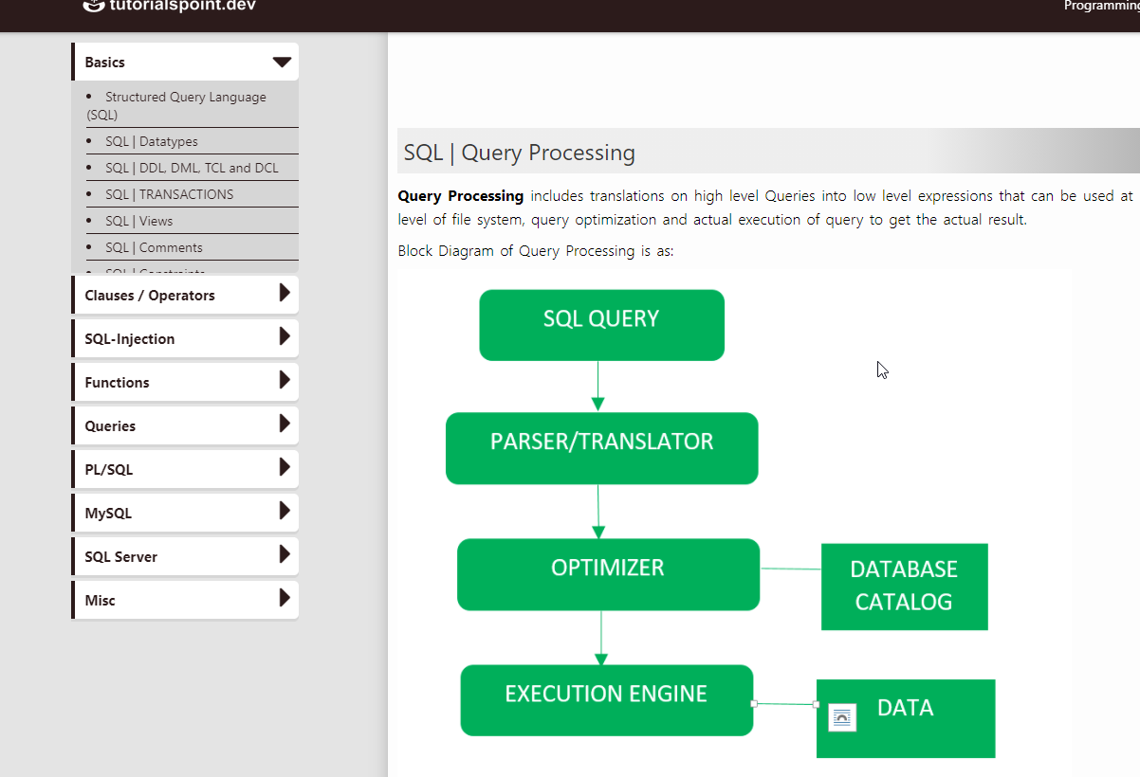
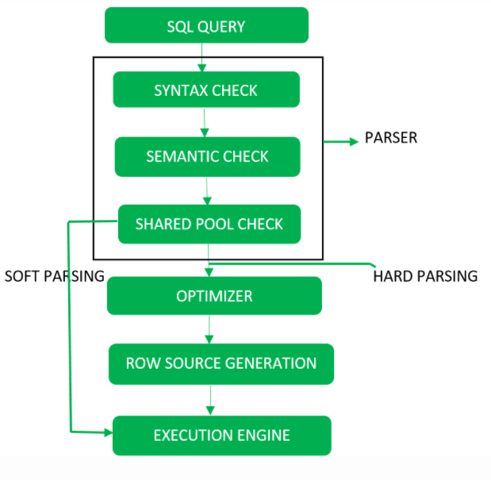
Query Processing
Query Processing includes translations on high level Queries into low level expressions that can be used at physical level of file system, query optimization and actual execution of query to get the actual result.
Block Diagram of Query Processing Detailed DiagramQuery Processing

Slide 126
Step-1
Parser: During parse call, the database performs the following checks- Syntax check, Semantic check and Shared pool check, after converting the query into relational algebra.
Parser performs the following
Syntax check – concludes SQL syntactic validity.
SELECT * FROM employee;
Semantic check – determines whether the statement is meaningful or not. Example: query contains a tablename which does not exist is checked by this check.
Shared Pool check – Every query possess a hash code during its execution. So, this check determines existence of written hash code in shared pool if code exists in shared pool then database will not take additional steps for optimization and execution.

Slide 127
Hard Parse and Soft Parse
If there is a fresh query and its hash code does not exist in shared pool then that query has to pass through from the additional steps known as hard parsing
If hash code exists then query does not passes through additional steps. It just passes directly to execution engine. This is known as soft parsing.
Step-2 Optimizer
During optimization stage, database must perform a hard parse at least for one unique DML statement and perform optimization during this parse. This database never optimizes DDL unless it includes a DML component such as subquery that require optimization.
It is a process in which multiple query execution plan for satisfying a query are examined and most efficient query plan is satisfied for execution.
Database catalog stores the execution plans and then optimizer passes the lowest cost plan for execution.

Slide 128
Row Source Generation
The Row Source Generation is a software that receives a optimal execution plan from the optimizer and produces an iterative execution plan that is usable by the rest of the database.
The iterative plan is the binary program that when executes by the sql engine produces the result set.
Step-3 Execution Engine
Finally runs the query and display the required result.

Slide 129


